Slide 1
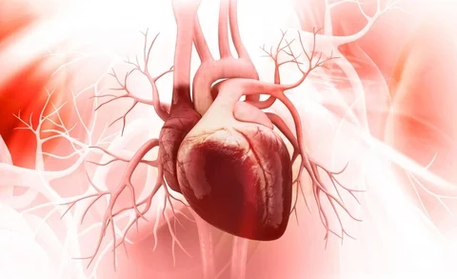
PROJECT TITLE PREDICT HEART FAILURE USING IBM AUTO AI SERVICE
TEAM -8 MEMBERS:
SAI SHARAN
RAJITHA PULI
ROUTHU SAHINI
AKASHAY REDDY
ROHAN KUMAR SINGH

Slide 2


INTRODUCTION
Heart failure is very hard to detect early, but with the help of a National Institutes of Health (NIH) grant, a team of scientists at IBM Research partnered with scientists from Sutter Health and clinical experts from Geisinger Health System to study and predict heart failure based on hidden clues in Electronic Health Records (EHRs).

Slide 3
.Over the last three years, using the latest advances in artificial intelligence (AI) like natural language processing, machine learning and big data analytics, the team trained models to identify heart failure one to two years earlier than a typical diagnosis today.
. We developed and applied several cognitive computing and AI technologies to analyze the patient data in the project including natural language processing and machine learning methods.
.A predictive model will be built using AutoAI on IBM Cloud Pak for Data. The model is then deployed to the Watson Machine Learning service, where it can be accessed via a REST API.

Slide 4
PROJECT AIM TO predict Heart Failure using IBM auto AI service
. Building a predictive model with AutoAI on Cloud Pak for Data.
. Deploying the model to the IBM Watson Machine Learning service.
. Via a Node.js app, score some data against the model via an API call to the Watson Machine Learning service
. predicting the heart failure paitent data where it is at RISK or NOT RISK.

Slide 5
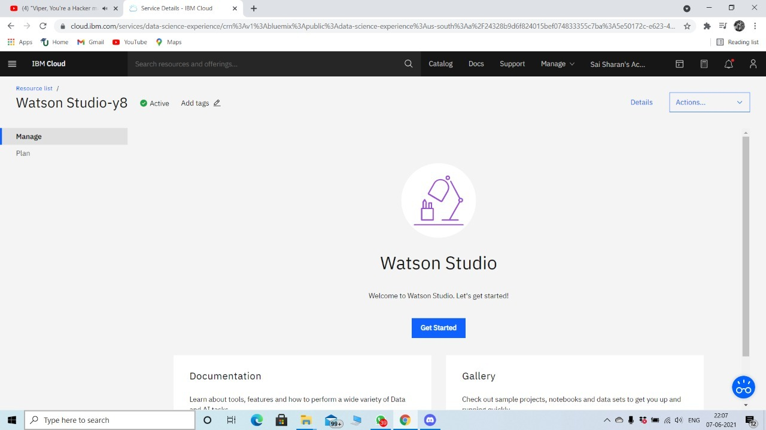
1.WATSON STUDIO

Slide 6
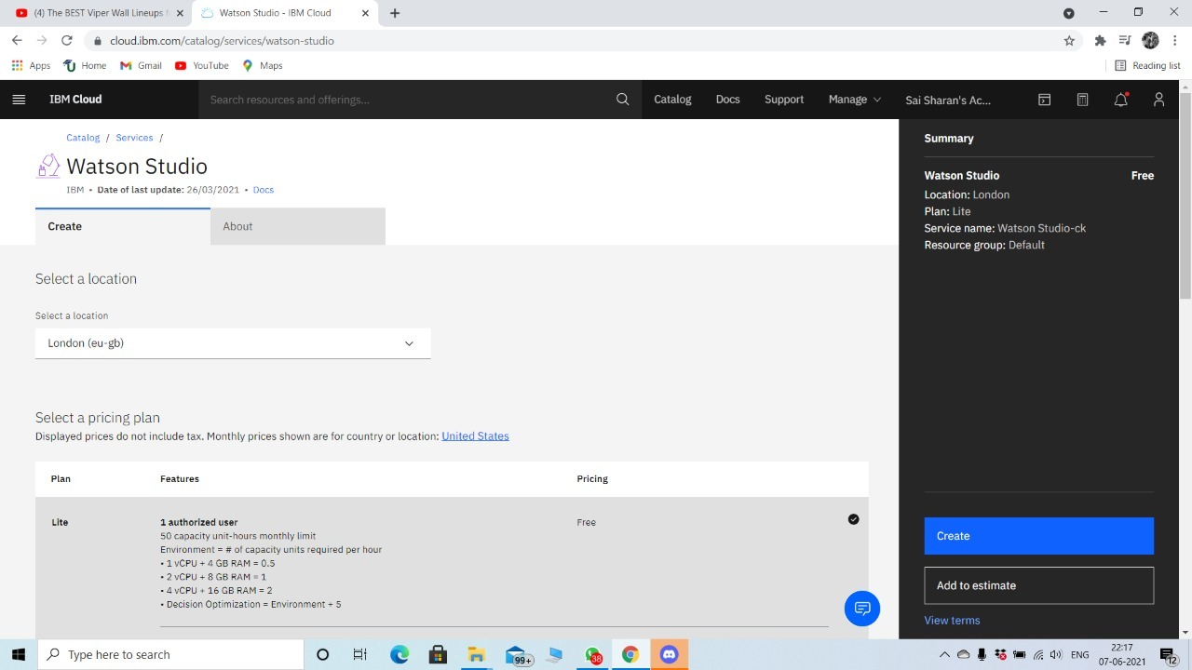
2.CREATING A WATSON STUDIO

Slide 7
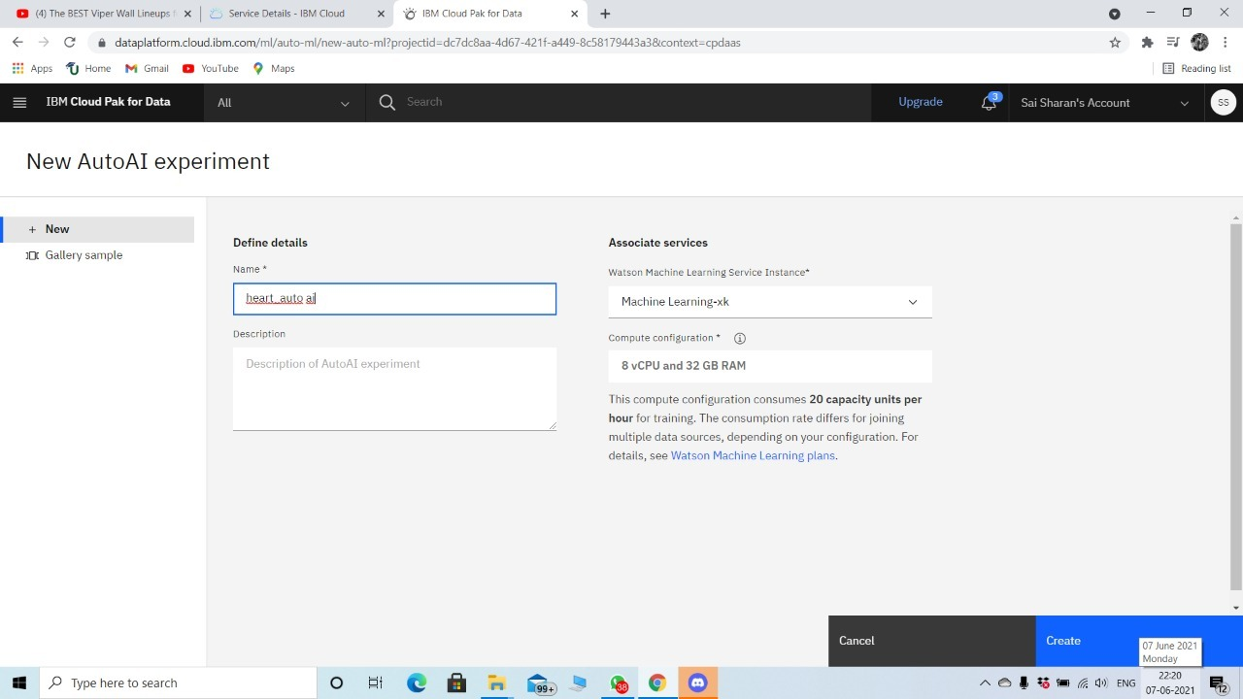
3.CREATED A MACHINE LEARINING SERVICE ,ADDED CLOUD OBJECT STORAGE AND CREATING NEW AUTOAI EXPERIMENT.

Slide 8
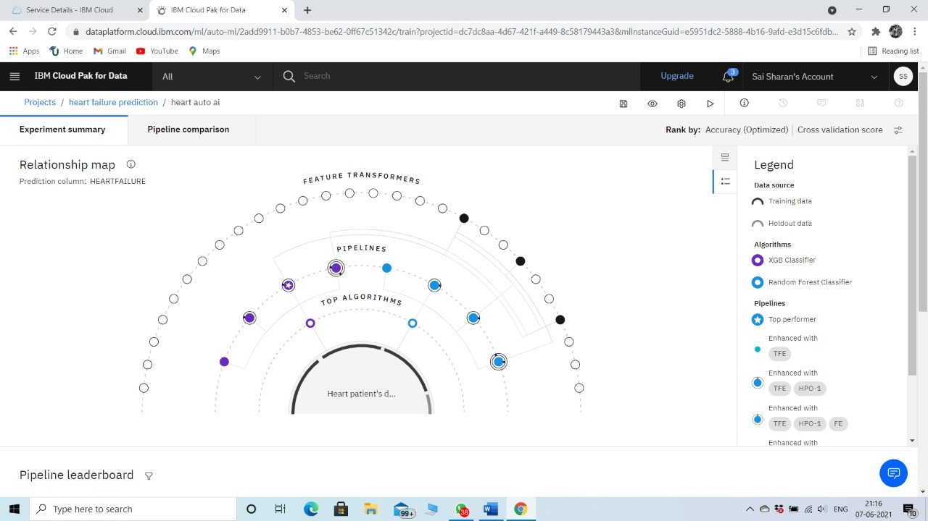
4.TRAINING THE MODEL

Slide 9
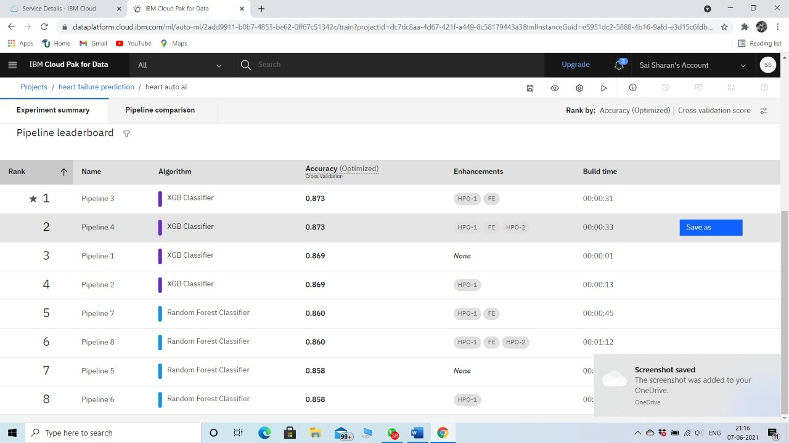

Slide 10
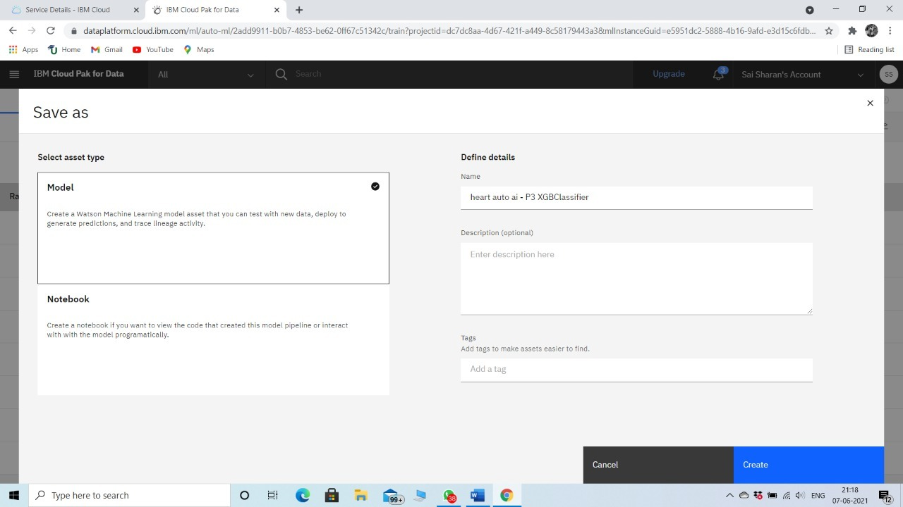
5.SAVING THE MODEL

Slide 11
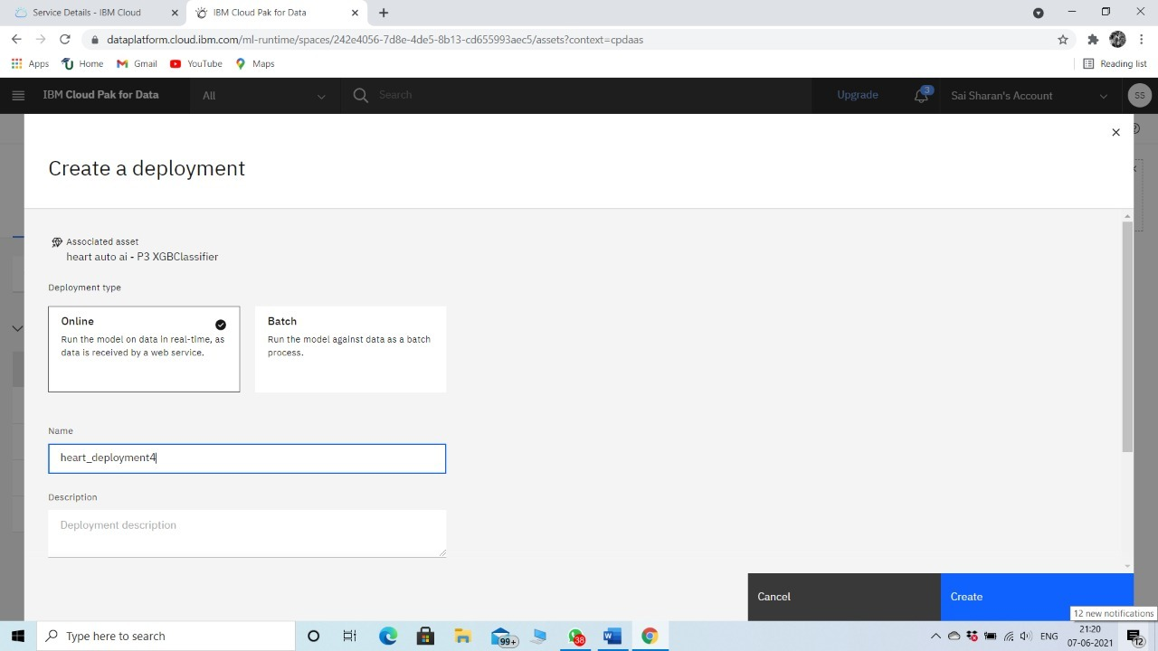
6.CREATING DEPLOYMENT

Slide 12
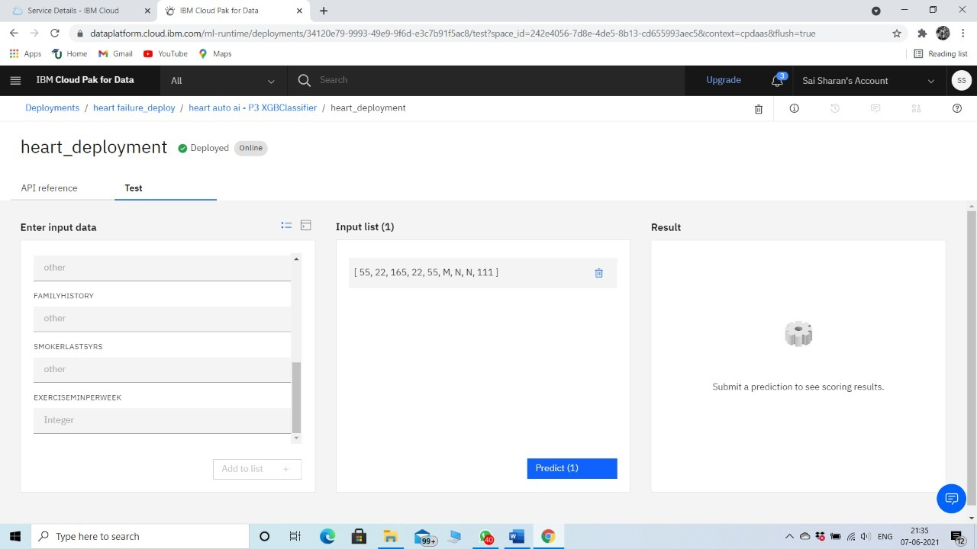

Slide 13
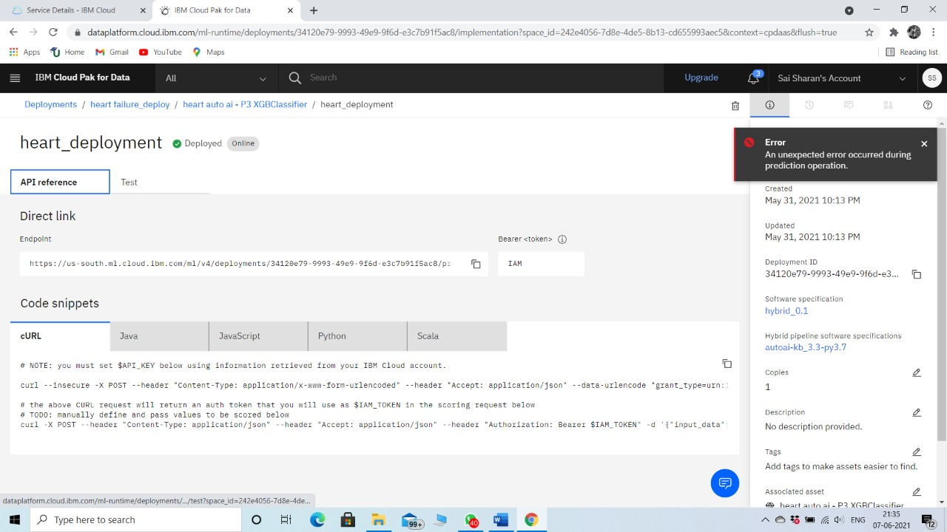
7.CREATING SCORING ENDPOINT

Slide 14
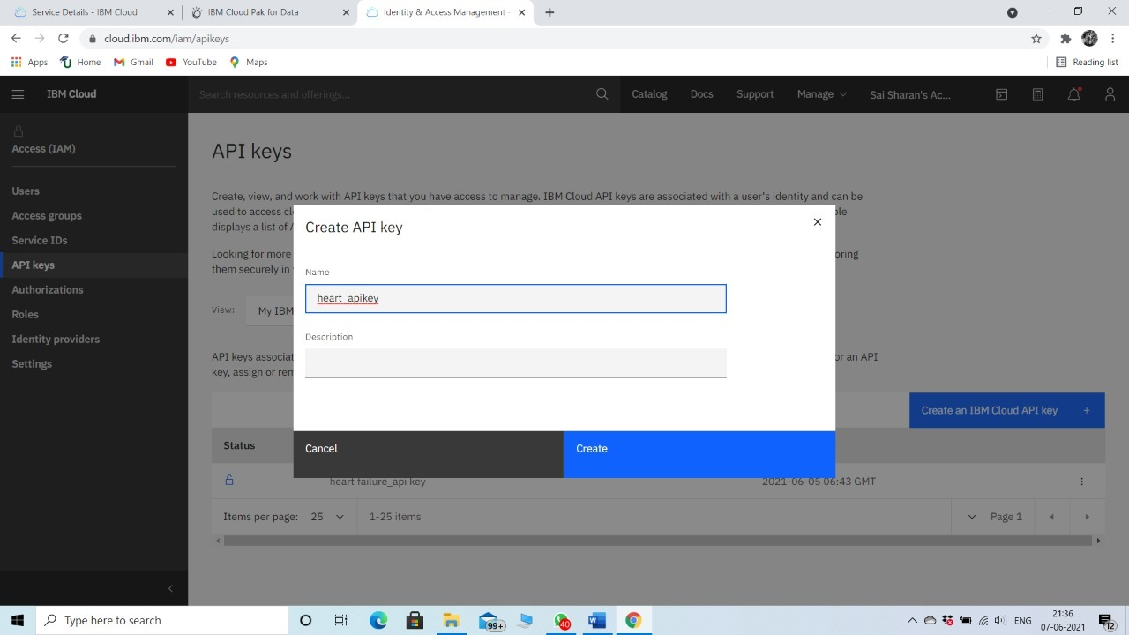
8.CREATING API KEY

Slide 15
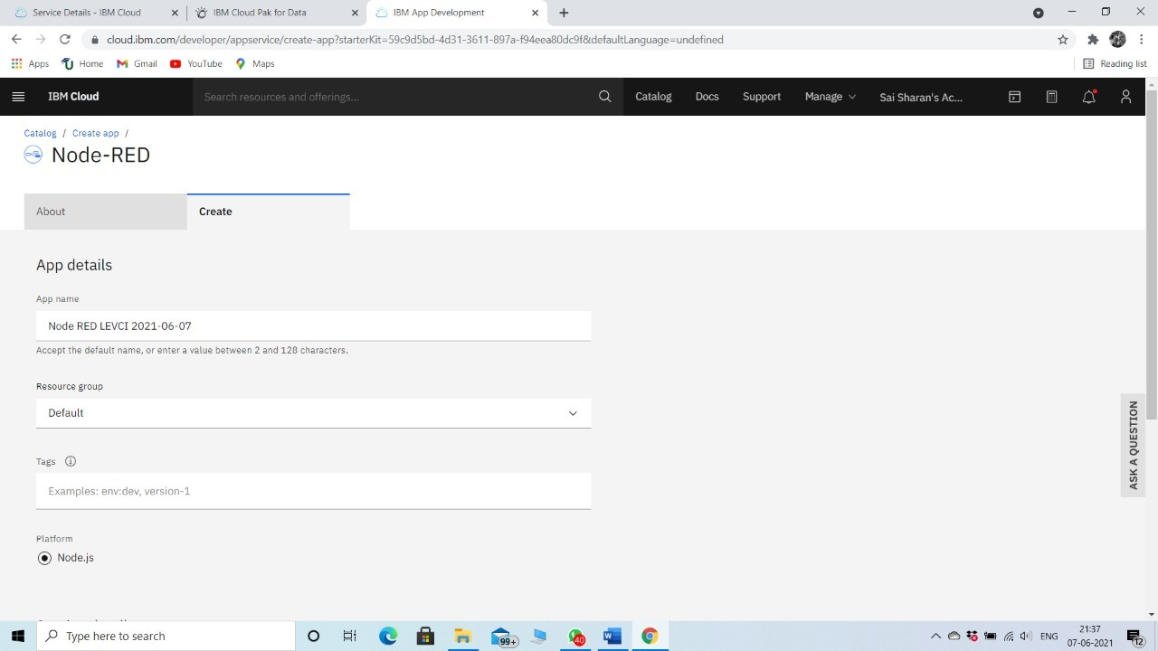
9.CREATING NODE-RED APP

Slide 16
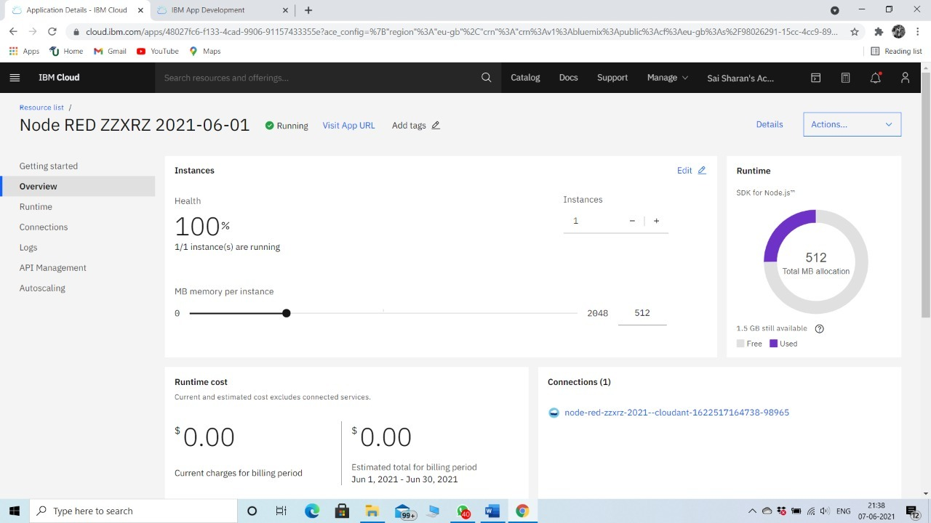

Slide 17
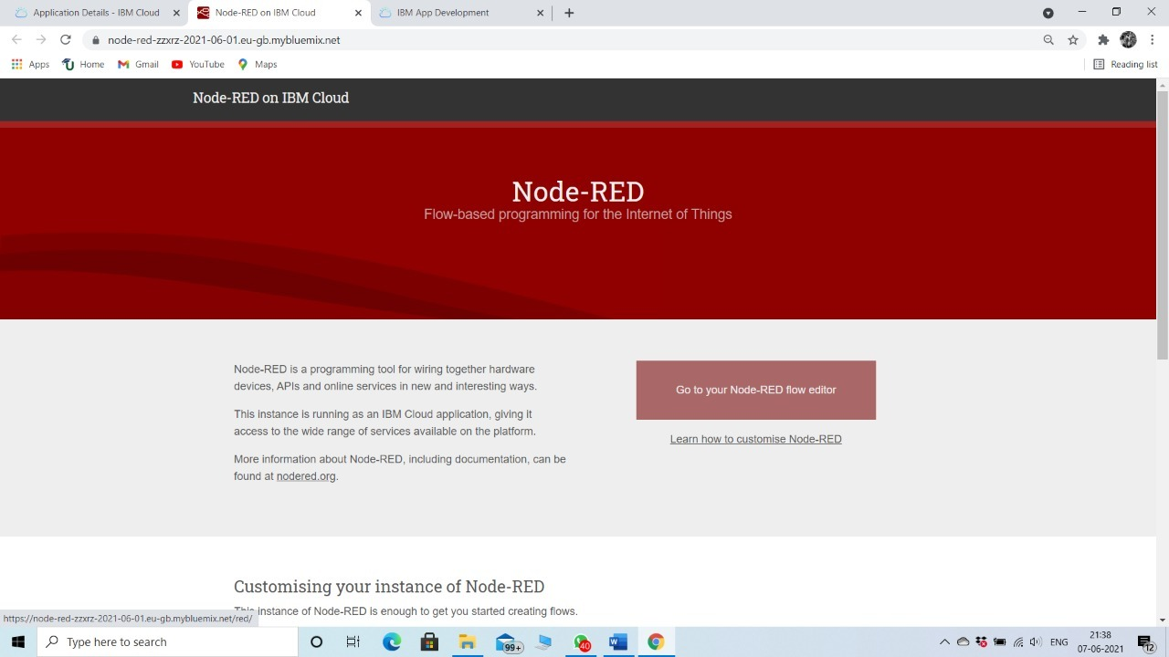

Slide 18
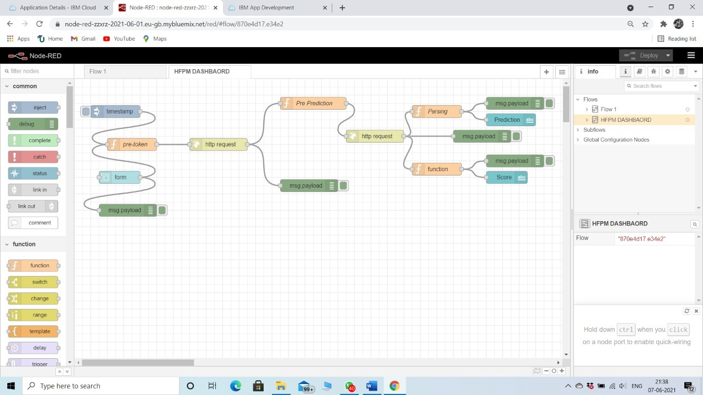
10.IMPORTING THE FLOW

Slide 19
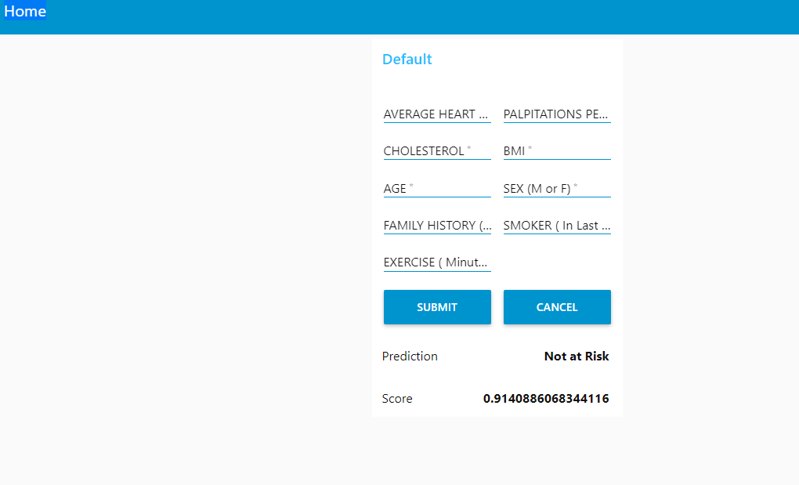
11.PROJECT RESULT

Slide 20

CONCLUSION
We could successfully predicted the heart at RISK or NOT by using IBM Auto AI service.
-Thank You-

